Slide 1

Break it
Till you make it
ShortStack Conf
3 Jul, 2021
Sayan Mondal, Software Engineer - ChaosNative

Slide 2





Software Engineer at
Contributor / Core Team member at
Sayan Mondal
@s_ayanide
@s-ayanide

Slide 3
Agenda
Chaos Engineering
Why do we need this? What are the problems?
Cloud Native Chaos Engineering
Different Tools in the market
Litmus overview

Slide 4
Chaos Engineering

Slide 5

DOWNTIMES ARE EXPENSIVE

Slide 6

Feedback loop can be activated by proactive testing in production
Test
Don’t wait

Slide 7






How is it done typically?
Only the SREs. Developers do not engage in Chaos Engineering
Rarely integrated into CI or CD system
Game Days
Chaos observability is not a commodity, it is a custom built stack at each enterprise
Custom measurement process for management to see any results on increase in reliability
Manual Planning & Execution

Slide 8
Cloud Native
Chaos Engineering

Slide 9
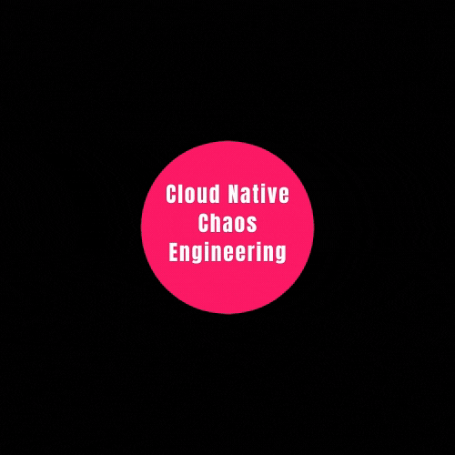
Built on the foundation of CNCE
Open Source
Open
Observability
Community Collaboration
Open API &
lifecycle management
GitOps

Slide 10
Different Chaos Engineering Tools out there
ChaosBlade
Pros:
Has application level fault injection for Java, C++, Node JS
Multiple ways of managing experiments
Cons:
Language Barrier
Lacks Scheduling, Safety Reporting
Chaos Mesh
Pros:
Has a WebUI which can control experiments
Support for CI/CD
Cons:
Dashboard is not very secure
Ad Hoc experiments run indefinitely
Chaos Toolkit
Pros:
Full Control over experiments
Built in logging and reporting
Cons:
No native scheduling
Limited Portability
No easy way to run attacks on multiple system

Slide 11



Feature complete for CNCE - Adoption ready
Open Source
Community Collaboration
Open
Observability
GitOps
Open API
& lifecycle mgmt

Slide 12
Litmus Overview

Slide 13

What is Litmus?
Litmus is a toolset to do cloud-native chaos engineering. Litmus provides tools to orchestrate chaos on Kubernetes to help SREs find weaknesses in their deployments. SREs use Litmus to run chaos experiments initially in the staging environment and eventually in production to find bugs, vulnerabilities.

Slide 14
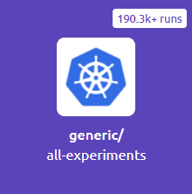
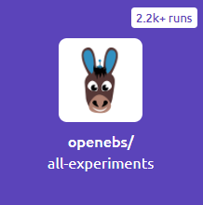
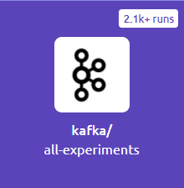
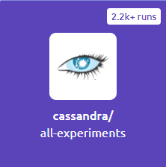
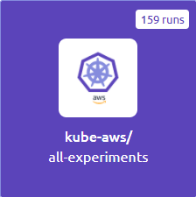
Experiments list
Pod Chaos | Node Chaos | Network Chaos | Stress Chaos | Cloud Services | Application Chaos
Pod Failure Container Kill Pod Autoscale | Node Drain Forced Eviction (Node Taints) Node Restart/PowerOff | Network Latency Packet Loss Network Corruption, Duplication | Pod, Node CPU Hog Pod, Node Memory Hog Pod, Node Disk Stress Pod Ephemeral Storage Fill | AWS EKS EC2 Termination AWS EBS Disk Detach GCP GPD Disk Detach | Kafka Leader Broker Failure Cassandra Ring Disruption OpenEBS Control Plane / Volume Failure

Slide 15
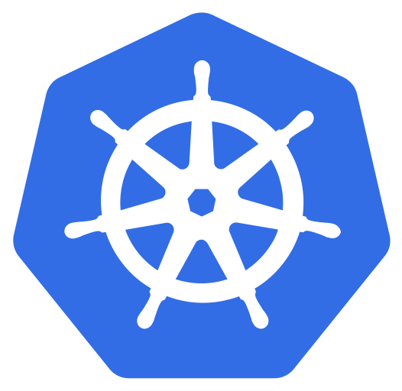
Litmus after you set it up
cloud/onprem
Chaos workflows
VMs/Baremetal
Chaos workflows
ArgoCD/FluxCD etc
A public ChaosHub
LitmusPortal
A private ChaosHub

Slide 16






Chaos in CI pipelines
CI/CD Pipeline
CHAOS STAGE
REMOTE TEMPLATES
CHAOS ACTIONS
chaos-operator
Litmus Chaos CI Lib
AUT FROM DEPLOY STAGE
chaos-experiments
PRECONFIGURED JOB PLUGIN
chaos-results
Ephemeral / Staging Cluster
LITMUS CONTROL PLANE PLUGIN

Slide 17





Litmus for non-Kubernetes chaos
Litmus Portal
Workflow Controller
Chaos Operator
Non K8s Chaos Experiment CR
Network
Access Control
API
Experiment Pod

Slide 18
Thank you

